Slide 1
INTRODUCTION TO MACHINE LEARNING
FUNDAMENTAL CONCEPTS
Andreu Arderiu
NORTHIN SUMMER SCHOOL
Barcelona, July 2022

Slide 2
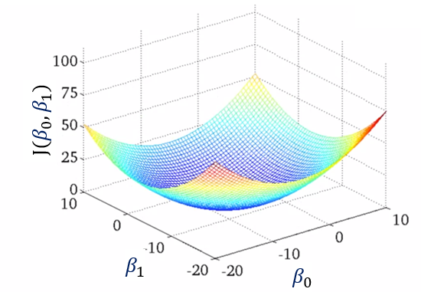
Linear regression: cost function
Minimize cost function: $J(β_{0},β_{1})=\frac{1}{n}\sum_{i=1}^{n}{{\left(h_{β}\left(x^{(i)}\right)−y^{(i)}\right)}^{2}}$
Gradient descent algorithm: Iterate $β_{j}:=β_{j} − α\frac{∂}{∂β_{j}}$ $J(β_{0},β_{1})$
Source: Coursera

Slide 3
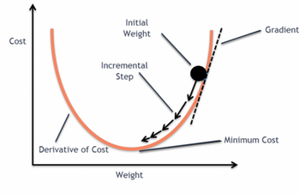
Gradient descent: find the weights minimizing cost

Slide 4
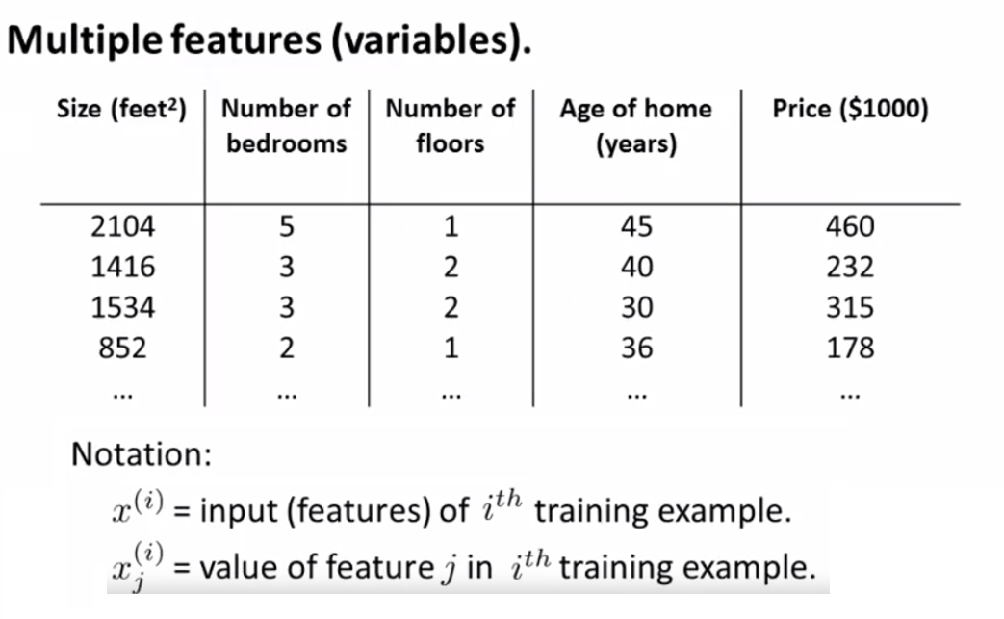
Multivariate linear regression: overview
Hypothesis: $h_{β}\left(x\right)=β_{0}+β_{1}x_{1}+ …+$ ${x_{m}β}_{m}=$ $β^{T}x$
Source: Coursera

Slide 5
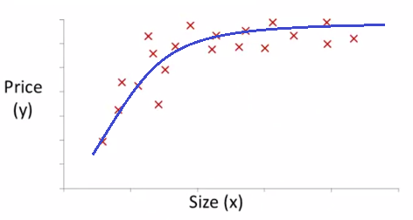
Polynomial regression
Non-linear combinations of $x$
Hypothesis: $h_{β}\left(x\right)=β_{0}+β_{1}x+{x^{2}β}_{2}+$ ${\sqrt{x}β}_{3}+…$

Slide 6
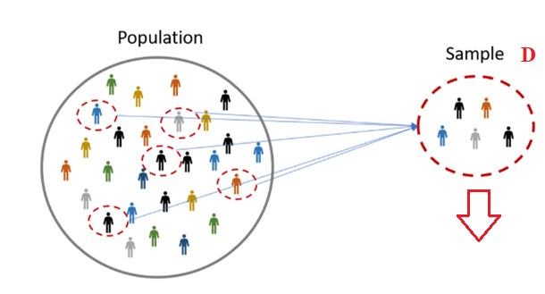
Model performance: finite samples
Most datasets are samples taken from an infinite population.
We are interested in modelling the whole population, we just have access to a finite sample.
Estimated model $f_{D}$
True model $f$
Source: Hotcubator

Slide 7
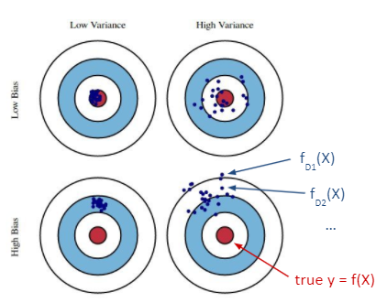
Model performance: Bias and variance
Consider a fixed $X$
Bias: Expected difference between predictions and true value
Variance: “Variability” of predictions
Source: Robert West, EPFL

Slide 8

Quizz: Bias and variance
Complex models (many parameters) have low/high bias?
low/high variance?
Simple models (few parameters) have low/high bias?
low/high variance?

Slide 9
Quizz: Bias and variance
Complex models (many parameters) have low/high bias?
low/high variance?
Simple models (few parameters) have low/high bias?
low/high variance?

Slide 10
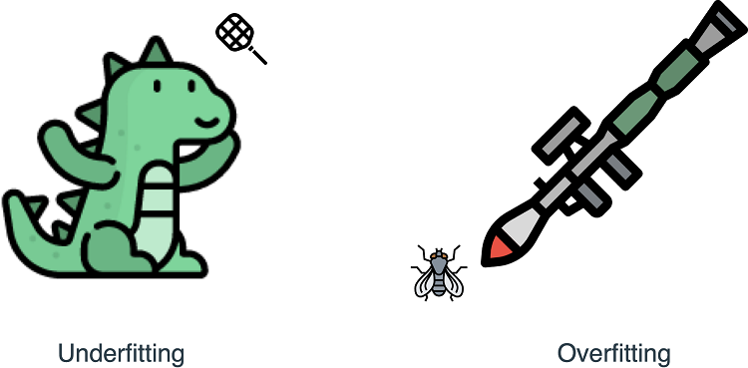
Overfitting: Bias-variance tradeoff
If we use too many features, the learned model may fit the training data very well (overfit), but fail to generalize to new examples
Image Credits: https://livebook.manning.com/

Slide 11
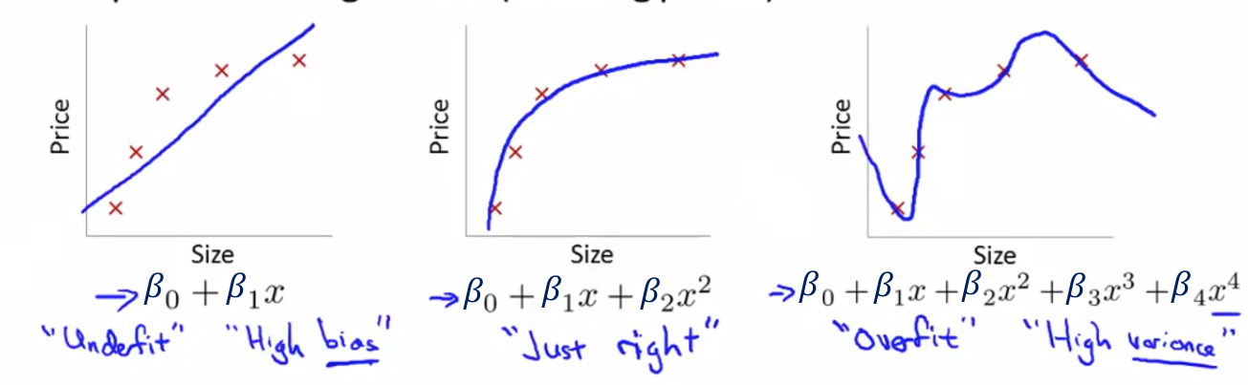
Overfitting: Bias-variance tradeoff
If we use too many features, the learned model may fit the training data very well (overfit), but fail to generalize to new examples
Source: Coursera

Slide 12
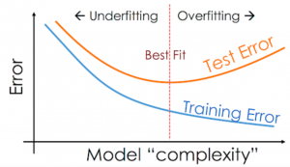
Overfitting: Bias-variance tradeoff
Ideally we want low bias (small training error) and low variance (small test error)
Source: Ajitesh Kumar

Slide 13
Overfitting: solutions
How to reduce overfitting?

Slide 14
Overfitting: solutions
How to reduce overfitting?
Reduce the number of features: Manually select/reduce the number of features to use
Regularization: Modify cost function to penalise number of weights or weights high values

Slide 15
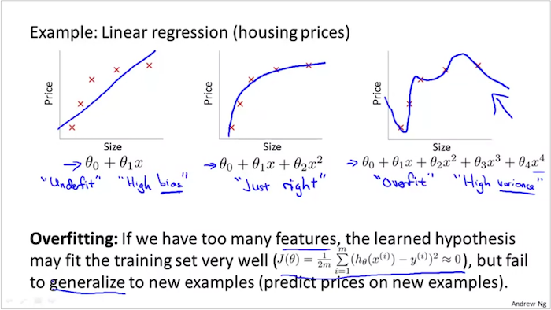
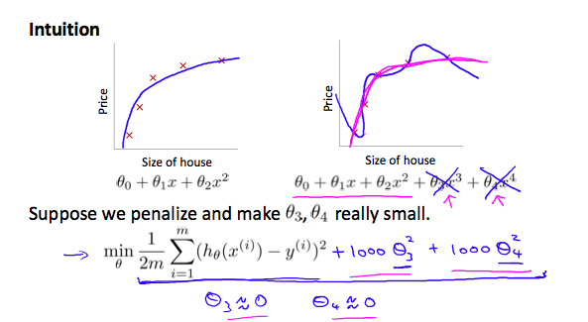
Regularization
Regularization helps us to maintain all variables or features in the model by reducing the magnitude of the variables. Hence, it maintains accuracy as well as the generalization power of the model.
Source: Coursera

Slide 16
Model selection: overview
Usually a classifier has some “hyperparameters” to be tuned
Linear regression: Number of features
Polynomial regression: Degree of the polynomial
Lasso/ridge regression: Regularization parameter $λ$
…
Hyperparameters are set before training can begin

Slide 17
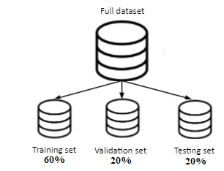
Model selection: Train/Validation/Test sets
Fit model parameters on training set
Choose model/hyperparameter configuration with lower validation error
Evaluate model performance with testing set
$$∼$$
$$∼$$
$$∼$$

Slide 18
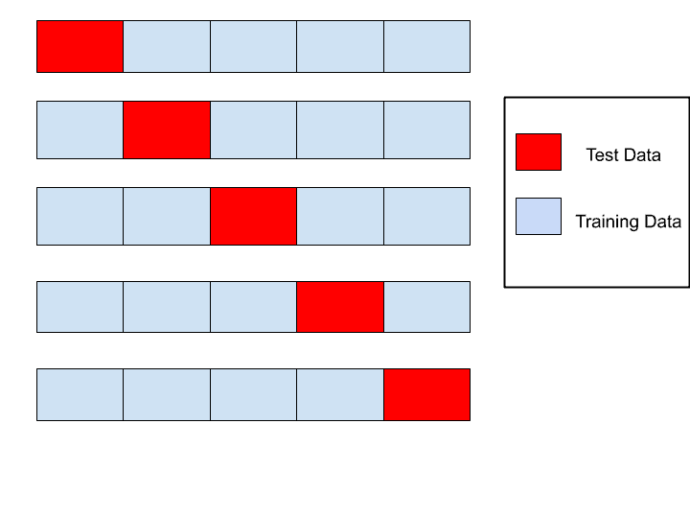
Model evaluation: k-fold cross-validation
More efficient way to compute validation error if we have little data
Average error over the k red portions Validation error
Fold 1
Fold 2
Fold 3
Fold 4
Fold 5
K=5
Source: MLTut

Slide 19
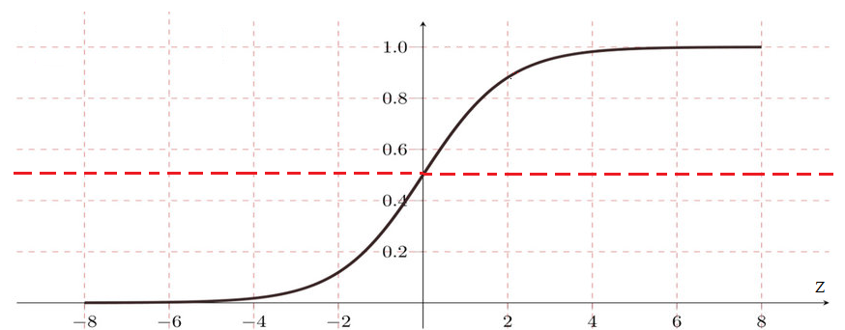

Logistic regression: overview
Supervised learning algorithm for classification tasks
Hypothesis:${ h}_{β}\left(x\right)=P\left(y=1 | x;β\right)=g\left(β^{T}x\right)=\frac{1}{1+e^{−β^{T}x}}$
$g(·)$ sigmoid or logistic function, values between 0 and 1
$$g\left(z\right)=\frac{1}{1+e^{−z}}$$
$$g\left(z\right)≥0.5 if z≥0$$

Slide 20
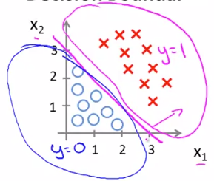
Logistic regression: decision boundary
Assume we predict $y=1$if ${ h}_{β}\left(x\right)=P\left(y=1 | x;β\right)≥0.5$
Example 1:
${ h}_{β}\left(x)=g(−3+x_{1}+x_{2}\right)$
$y=1 if −3+x_{1}+x_{2}≥0$;
Decision boundary $x_{1}+x_{2}=3$
Source: Coursera

Slide 21
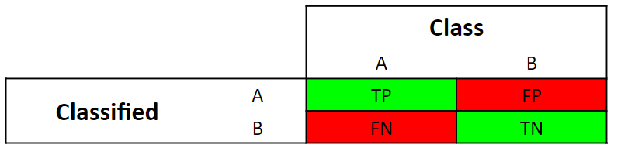

Performance metrics for classification
In binary classification (Yes/no, 0/1), we use the confusion matrix which has 4 values:
True positives: positive examples classified as positive
True negatives: negative examples classified as negative
False positives: negative examples classified as positive
False negatives: positive examples classified as negative
$$Credit:Robert West, EPFL$$

Slide 22

Accuracy: overview
Represents the % of correctly predicted cases
$A=\frac{TP+TN}{TP+TN+FP+FN}=\frac{TP+TN}{N}$
Good metric when
Classes are not skewed
Errors (FP, FN) have the same importance
Source: Avinash Pandey

Slide 23
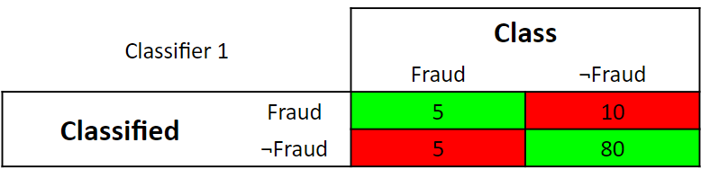



Accuracy: skewed example
$$A=\frac{85}{100}=0.85$$
$$A=\frac{90}{100}=0.90$$
$$Credit:Robert West, EPFL$$
$$Credit:Robert West, EPFL$$

Slide 24
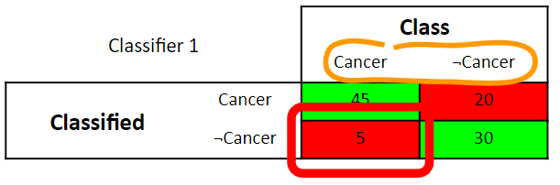
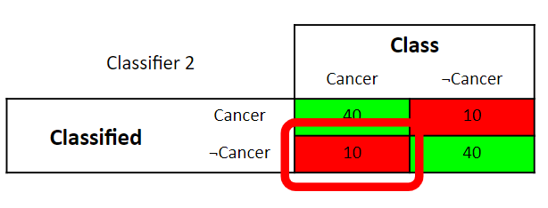


Accuracy: errors with different importance
$$A=\frac{75}{100}=0.75$$
$$A=\frac{80}{100}=0.80$$
$$Credit:RobertWest, EPFL$$
$$Credit:RobertWest, EPFL$$

Slide 25
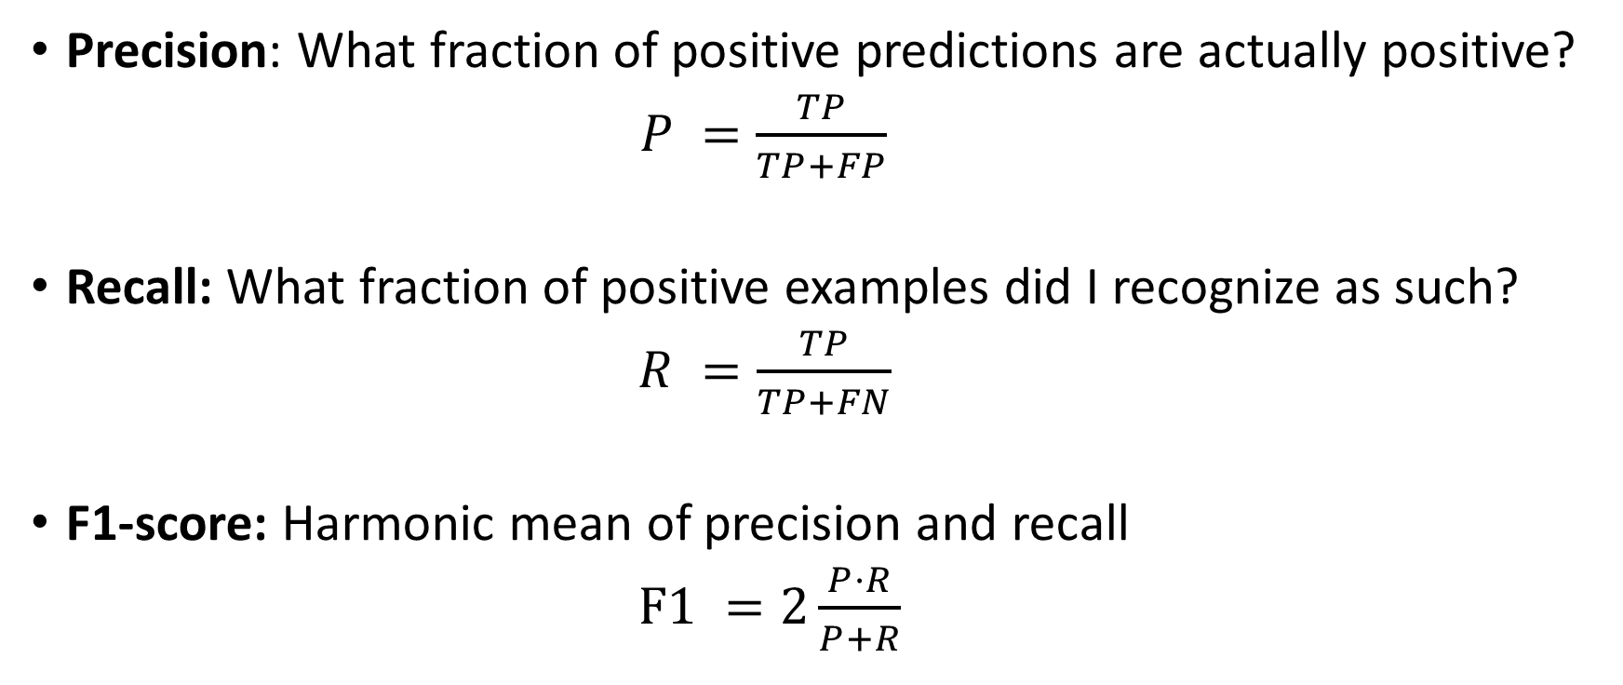
Precision, recall, F1-score
Precision: What fraction of positive predictions are actually positive?
$P =\frac{TP}{TP+FP}$
Recall: What fraction of positive examples did I recognize as such?
$R =\frac{TP}{TP+FN}$
F1-score: Harmonic mean of precision and recall
$F1 =2\frac{P·R}{P+R}$

